Slide 1


Spencer Ng
26/05/2024

Slide 2

Section 1

Slide 3

Outline
Executive Summary
Introduction
Methodology
Results
Conclusion
Appendix

Slide 4
Executive Summary
Summary of methodologies
SpaceX Data Collection using SpaceX API
SpaceX Data Collection with Web Scraping
SpaceX Data Wrangling
SpaceX EDA using SQL
Space-X EDA Data Visulaization with Pandas and Matplotlib
Space-X Launch Sites Analysis with Folium and PlotlyDash
SpaceX Machine Learning Landing Prediction
Summary of all results
EDA results
Interactive Visualization and Dashboards
Machine Learning delivering predictive analytics

Slide 5
Methodology
Executive Summary
Data collection methodology:
Describe how data was collected
Perform data wrangling
Describe how data was processed
Perform exploratory data analysis (EDA) using visualization and SQL
Perform interactive visual analytics using Folium and Plotly Dash
Perform predictive analysis using classification models
How to build, tune, evaluate classification models

Slide 6
Data Collection
Describe how data sets were collected.
Data was first collected using SpaceX API (a REST API) by making a get request to the SpaceX API.
This API gives us info about payload mass, launchsites, orbits, landing outcomes and other useful datapoints that can be used to making predictions
Another source for getting Space X data is webscraping Wikipedia using Beatiful soup

Slide 7
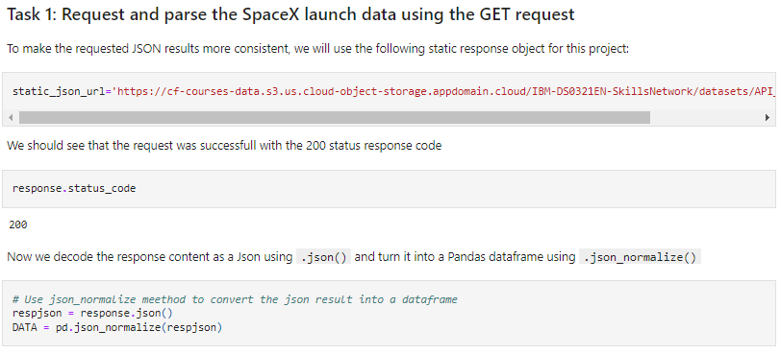
Data Collection – SpaceX API
Data collected using SpaceX API . Input get request to the SpaceX API and decoded the response content as a Json result which is then converted into a Pandas data frame
Add the GitHub URL of the completed SpaceX API calls notebook https://github.com/SuperVerkaufer/IBM-data-science-capstone/blob/5273bb1d13679321338e0d582b9767dc04218309/2.%20Data%20Collection.ipynb
Flow diagram

Slide 8
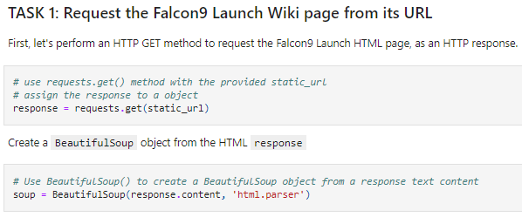
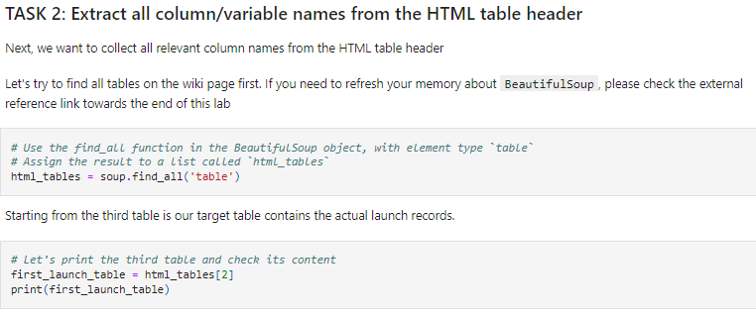
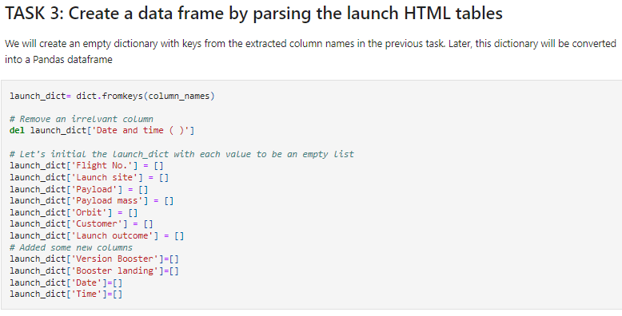
Data Collection - Scraping
Scraped Falcon 9 historical launch records from Wikipedia using BeautifulSoup request, to extract the Falcon 9 launch records from the HTML table of the Wikipedia page, then created a data frame by parsing the launch HTML.
Add the GitHub URL of the completed web scraping notebook, as an external reference and peer-review purpose
https://github.com/SuperVerkaufer/IBM-data-science-capstone/blob/5273bb1d13679321338e0d582b9767dc04218309/3.%20webscraping.ipynb
Flow diagram

Slide 9
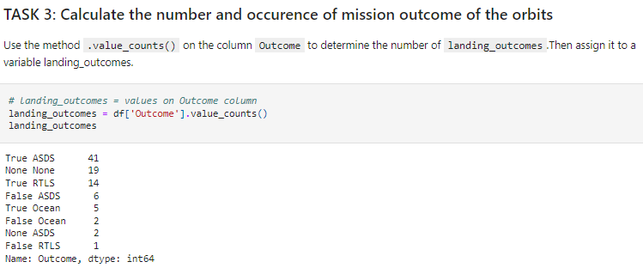
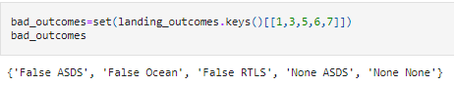
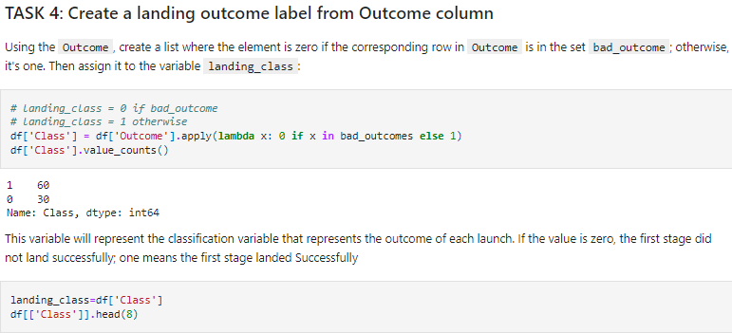
Data Wrangling
Enumerate the various outcomes and then group them by good or bad outcomes
Subsequently code the outcomes as either good or bad outcomes
Add the GitHub URL of your completed data wrangling related notebooks, as an external reference and peer-review purpose
https://github.com/SuperVerkaufer/IBM-data-science-capstone/blob/5273bb1d13679321338e0d582b9767dc04218309/4.%20Data%20wrangling.ipynb
Flow diagram

Slide 10
EDA with Data Visualization
Used scatter plots to visualize the relationship between 1) Flight Number VS Launch Site, 2) Payload mass and Launch Site, 3) FlightNumber and Orbit type, 4) Payload mass and Orbit type.
Used Bar chart to visualize the success rate of each orbit type
Line plot to show the launch success yearly increasing trend.
Add the GitHub URL of your completed EDA with data visualization notebook, as an external reference and peer-review purpose
https://github.com/SuperVerkaufer/IBM-data-science-capstone/blob/5273bb1d13679321338e0d582b9767dc04218309/6.%20eda%20data%20visualization.ipynb

Slide 11
EDA with SQL
Display the names of the unique launch sites in the space mission
Display 5 records where launch sites begin with the string 'CCA‘
Display the total payload mass carried by boosters launched by NASA (CRS)
Display average payload mass carried by booster version F9 v1.1
List the date when the first successful landing outcome in ground pad was achieved
List the names of the boosters which have success in drone ship and have payload mass greater than 4000 but less than 6000
List the total number of successful and failure mission outcomes
Add the GitHub URL of your completed EDA with SQL notebook, as an external reference and peer-review purpose
https://github.com/SuperVerkaufer/IBM-data-science-capstone/blob/5273bb1d13679321338e0d582b9767dc04218309/5.%20eda%20SQL.ipynb

Slide 12
Build an Interactive Map with Folium
Developed folium map to mark all the launch sites, and created map objects such as markers, circles, lines to mark the success or failure of launches for each launch site.
launch outcomes were denoted as failure=0 or success=1.
Add the GitHub URL of your completed interactive map with Folium map, as an external reference and peer-review purpose
https://github.com/SuperVerkaufer/IBM-data-science-capstone/blob/5273bb1d13679321338e0d582b9767dc04218309/7.%20Launch%20site%20location%20analysis.ipynb

Slide 13
Build a Dashboard with Plotly Dash
Built an interactive dashboard application with Plotlydash by:
Created a Launch Site Drop-down Input Component
Created a callback function to render success-pie-chart based on selected site in the dropdown menu
Created a Range Slider to Select Payload
Created a callback function to render the success-payload-scatter-chart to showcase success by payload mass
Add the GitHub URL of your completed Plotly Dash lab, as an external reference and peer-review purpose
https://github.com/SuperVerkaufer/IBM-data-science-capstone/blob/5273bb1d13679321338e0d582b9767dc04218309/8.%20Interactive%20Dashboard%20with%20Plotly%20-%20SpaceX%20Dash

Slide 14
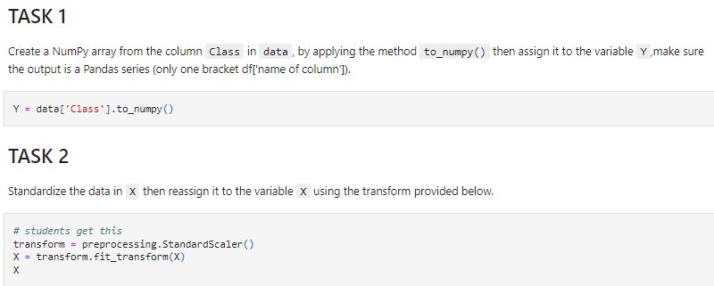
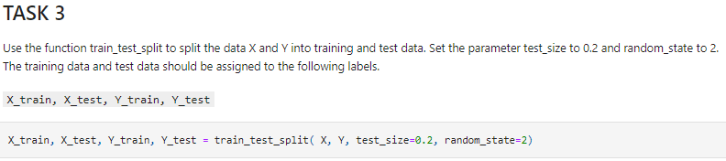
Predictive Analysis (Classification)
Prepared the data for modelling. First creating a Numpy array, then standardizing the data and finally splitting the data into training (to fit the data into the model) and test sets (to validate the model)
Add the GitHub URL of your completed predictive analysis lab, as an external reference and peer-review purpose
https://github.com/SuperVerkaufer/IBM-data-science-capstone/blob/fa8728e617f190b21d2c0b8dfbf109936a37e1a1/9.%20SpaceX_Machine%20Learning%20Prediction_Part_5.ipynb
Flow diagram

Slide 15
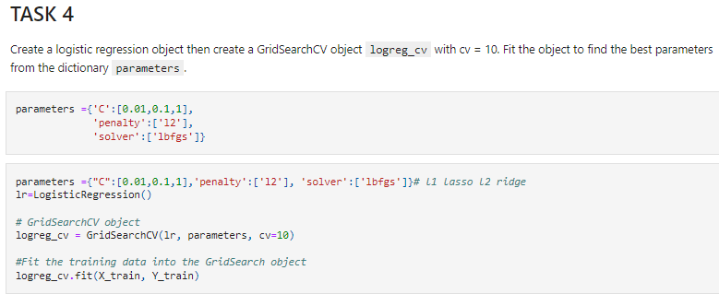
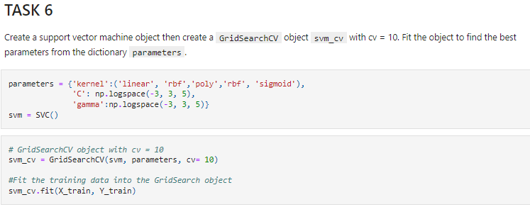
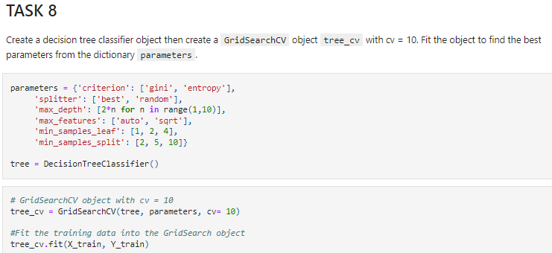
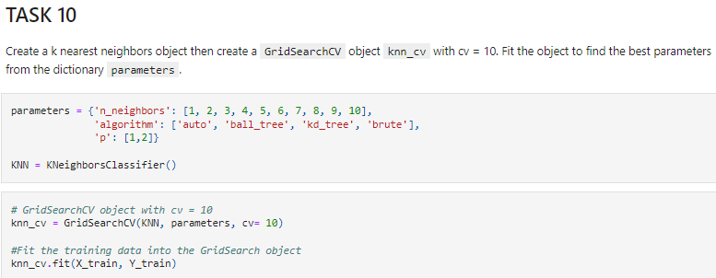
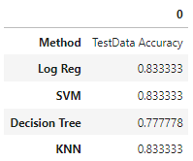
Predictive Analysis (Classification)
Built various models so that we can identify the best one.
For each of the models, the GridsearchCV object was created with cv=10, then fit the training data into the GridSearch object
The table shows the test data accuracy score for each model comparing them to show which performed best
Flow diagram

Slide 16

Section 2

Slide 17
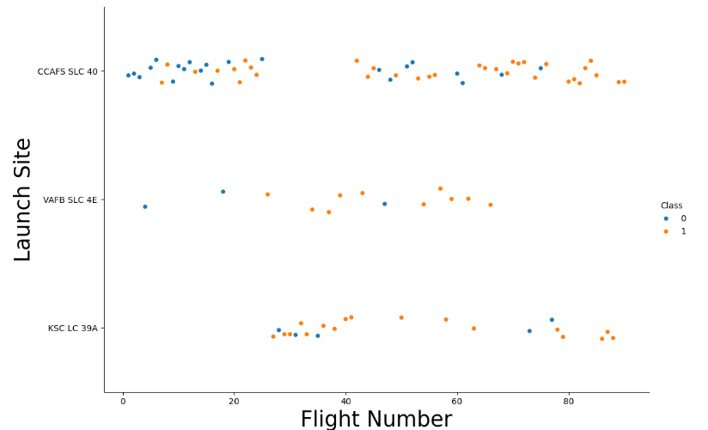
Flight Number vs. Launch Site
Across launch sites; Successful landing (1) increases as flight number increases

Slide 18
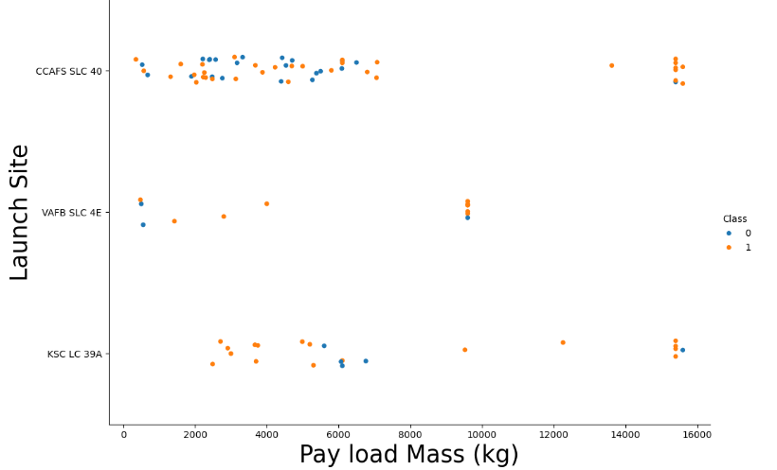
Payload vs. Launch Site
Across launch sites; Successful landing (1) increases as Pay Load Mass increases

Slide 19
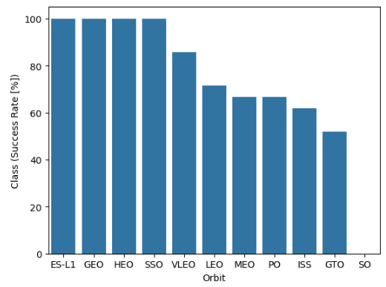
Success Rate vs. Orbit Type
Orbits ES-L1, GEO, HEO, SSO have 100% success rate of landing

Slide 20
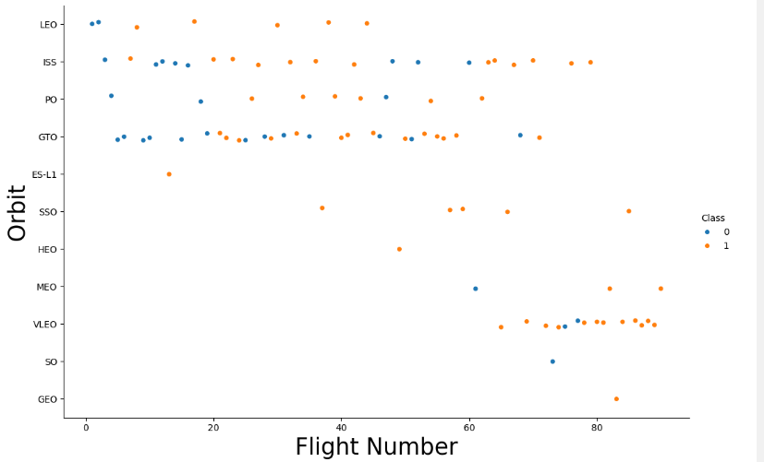
Flight Number vs. Orbit Type
Only LEO orbit shows clear increasing successful landing with increasing flight number

Slide 21
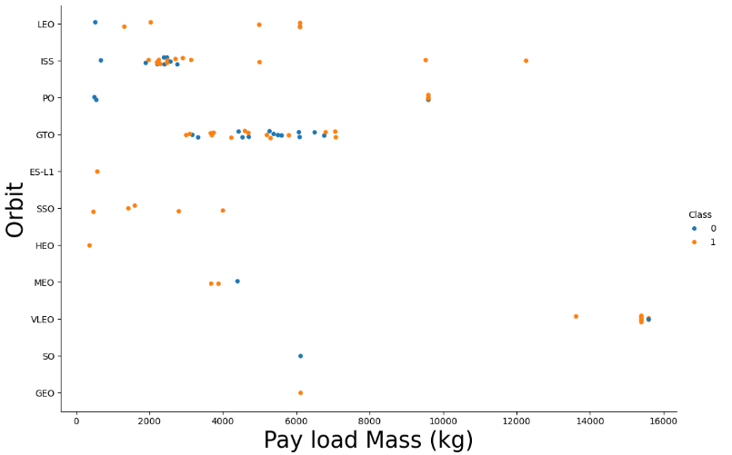
Payload vs. Orbit Type
Only LEO, ISS & PO shows clear increasing successful landing with increasing payload mass

Slide 22
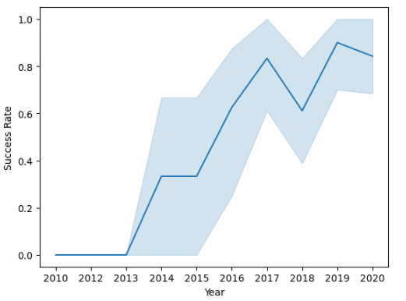
Launch Success Yearly Trend
Increase in successful landing rate since 2013

Slide 23
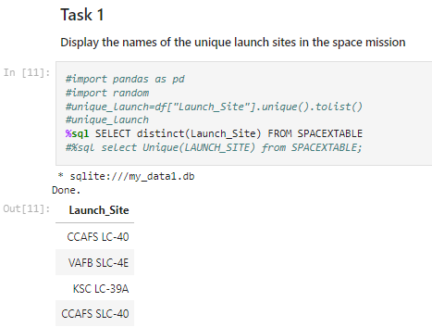
All Launch Site Names
SQL Select Distinct used to find and show unique launch sites

Slide 24
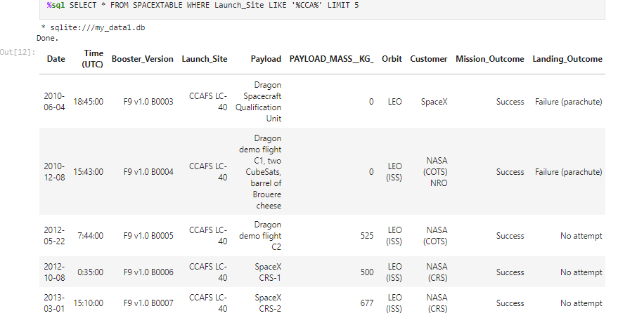
Launch Site Names Begin with 'CCA'
Select instances where launchsites correspond to %CCA% from table and limit 5 instances

Slide 25
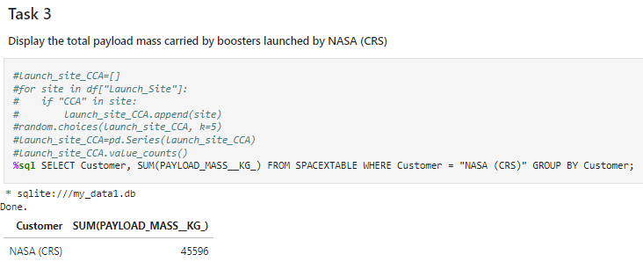
Total Payload Mass
Sum of group by corresponding to NASA customer produces the total payload mass for NASA

Slide 26
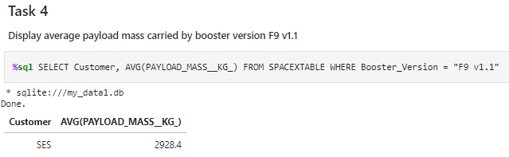
Average Payload Mass by F9 v1.1
Avg of group by corresponding to booster version F9 V1.1

Slide 27
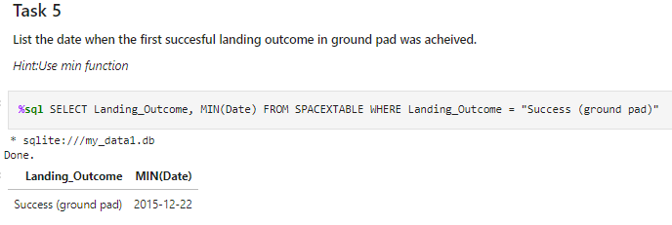
First Successful Ground Landing Date
Identify earliest successful landing by applying MIN on Date amongst successful landing outcomes

Slide 28
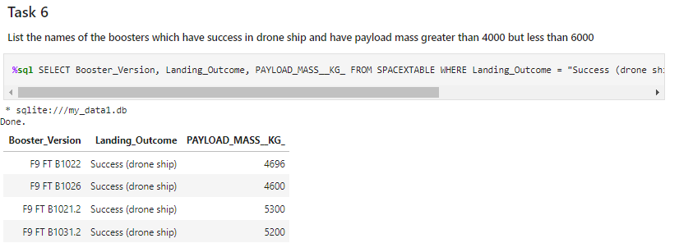
Successful Drone Ship Landing with Payload between 4000 and 6000
Select booster version, amongst successful drone ship landing as landing outcome

Slide 29
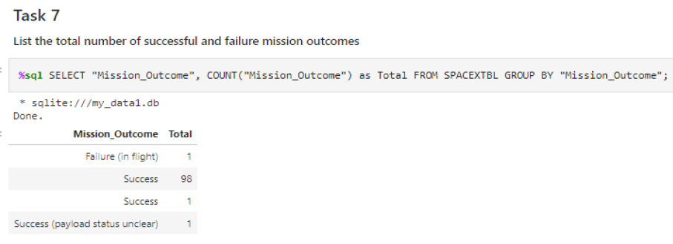
Total Number of Successful and Failure Mission Outcomes
Use Group By and count mission outcome within each group

Slide 30
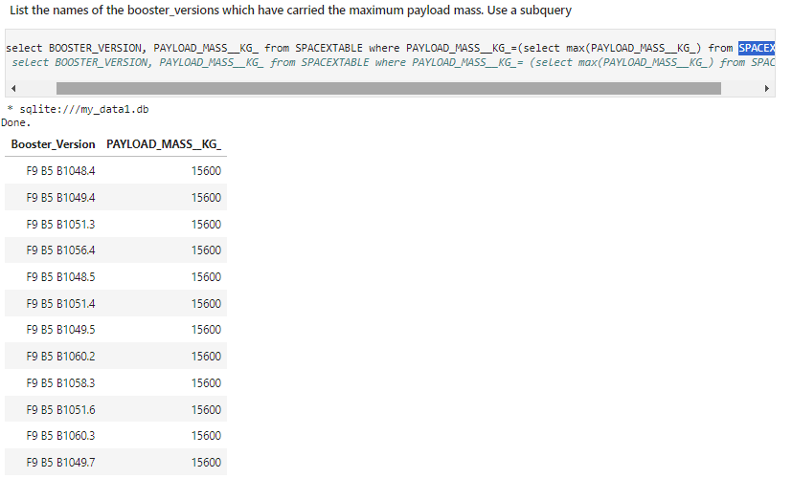
Boosters Carried Maximum Payload
Names of boosters identified by applying MAX to Payload Mass from SPACEXTABLE

Slide 31
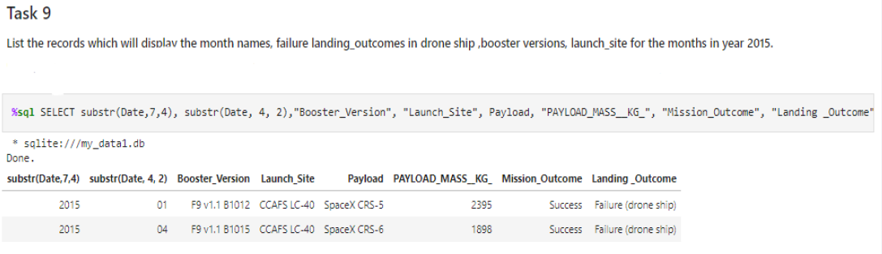
2015 Launch Records
Apply the ‘subsrt()’ in the select statement to get month & year from the date variable where substr(Date,7,4)='2015' for year and Landing_outcome was ‘Failure (drone ship’) and return the records

Slide 32
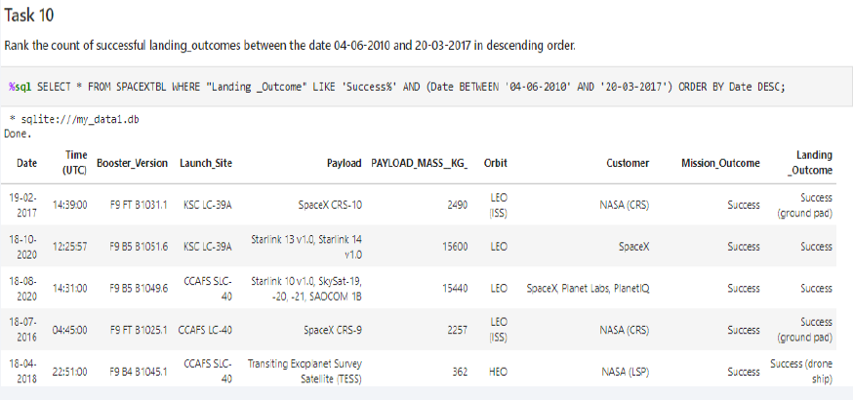
Rank Landing Outcomes Between 2010-06-04 and 2017-03-20
Rank order by dates but includes both successful landings and failures

Slide 33

Section 3

Slide 34
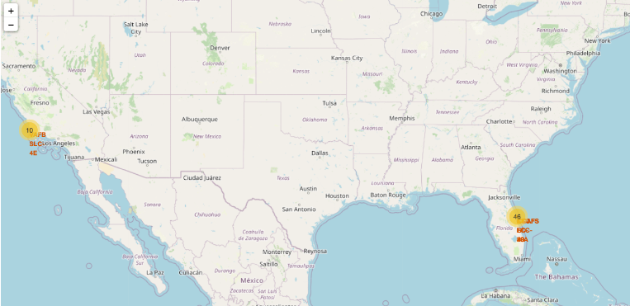
All launch site locations
All launch sites are at the coastline

Slide 35
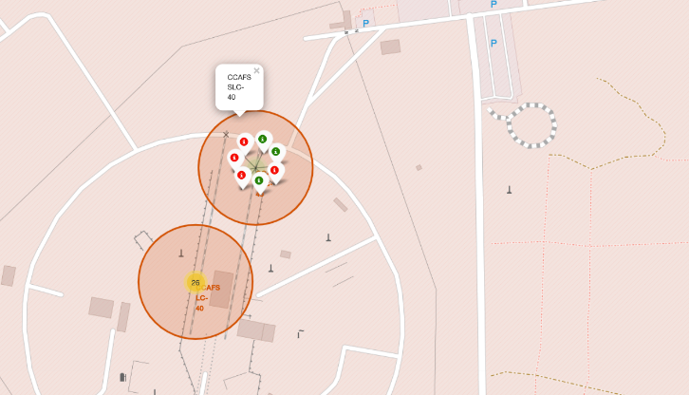
Launch Outcomes
CCAFS SLC40 has 3 successful launch outcomes out of 7

Slide 36
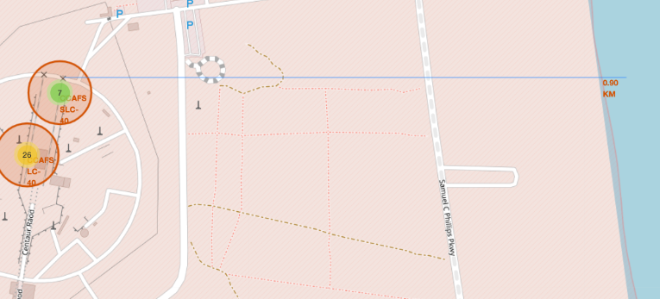
Proximity of launch site to coastline
Proximity of launchsite is 0.9KM to coastline

Slide 37

Section 4

Slide 38
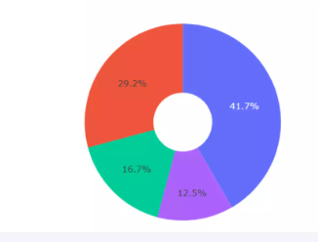
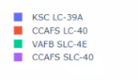
Total success launches across all sites
Here you can see success by all sites, led by KSC LC39A

Slide 39
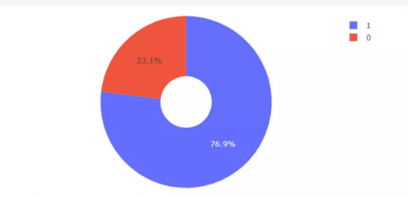
Success rate by site
KSC LC 39-A achieved a 76.9% success rate and thus the site with highest success rate

Slide 40
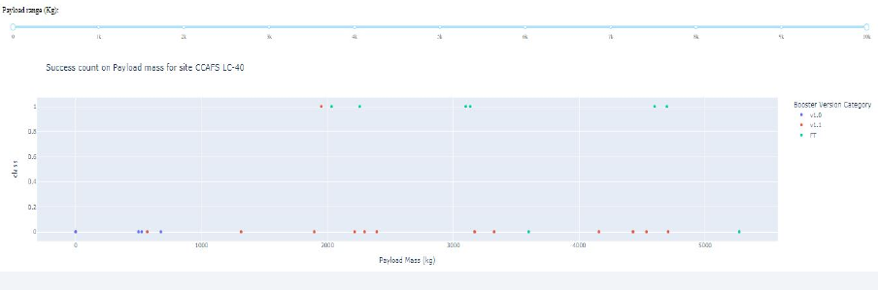
Payload mass vs launch outcome by sites
Success rate improves with rising payload mass

Slide 41

Section 5

Slide 42
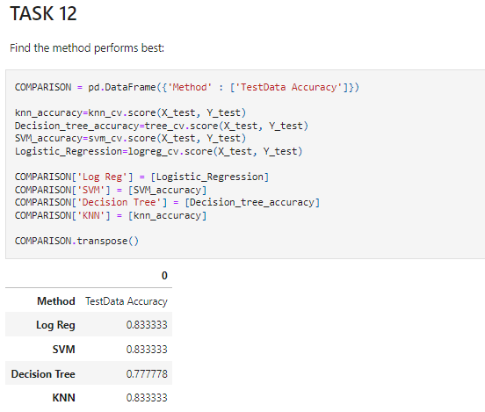
Classification Accuracy
All models had the same level of accuracy except for decision tree which has the poorest accuracy

Slide 43
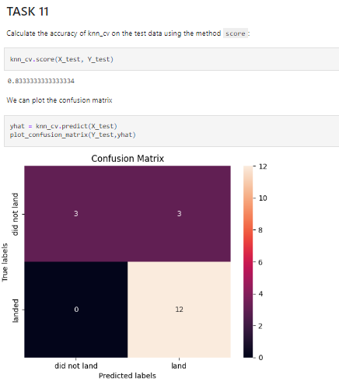
Confusion Matrix
Most of the models had the same accuracy – meaning it could predict accurately all the successful outcomes. But it also produced false positives. The KNN model is shown as an example

Slide 44
Conclusions
The most predictive variables of a successful launchsite is 1) PayLoad Mass, 2) Number of Flights, 3) Orbits ES-L1, GEO, HEO & SSO are the most successful
Furthmore, launches after 2013 were also successful
Various models were tried to see which model achieved the best fit. Apart from decision tree, which achieved the poorest accuracy, the rest of the models achieved comparable accuracy

Slide 45
Appendix
Include any relevant assets like Python code snippets, SQL queries, charts, Notebook outputs, or data sets that you may have created during this project

Slide 46


